Slide 1
Communicating with Data – Visualization Fundamentals Pt. 2
Dr. Ab Mosca (they/them)
Slides based off slides courtesy of Jordan Crouser (https://jcrouser.github.io/)

Slide 2
Plan for Today
Refresher: mental models
Putting marks together
Group activity: what we draw vs. what we see
Refresher: building blocks
Choosing visual channels
Group activity: does this follow the rules?

Slide 3
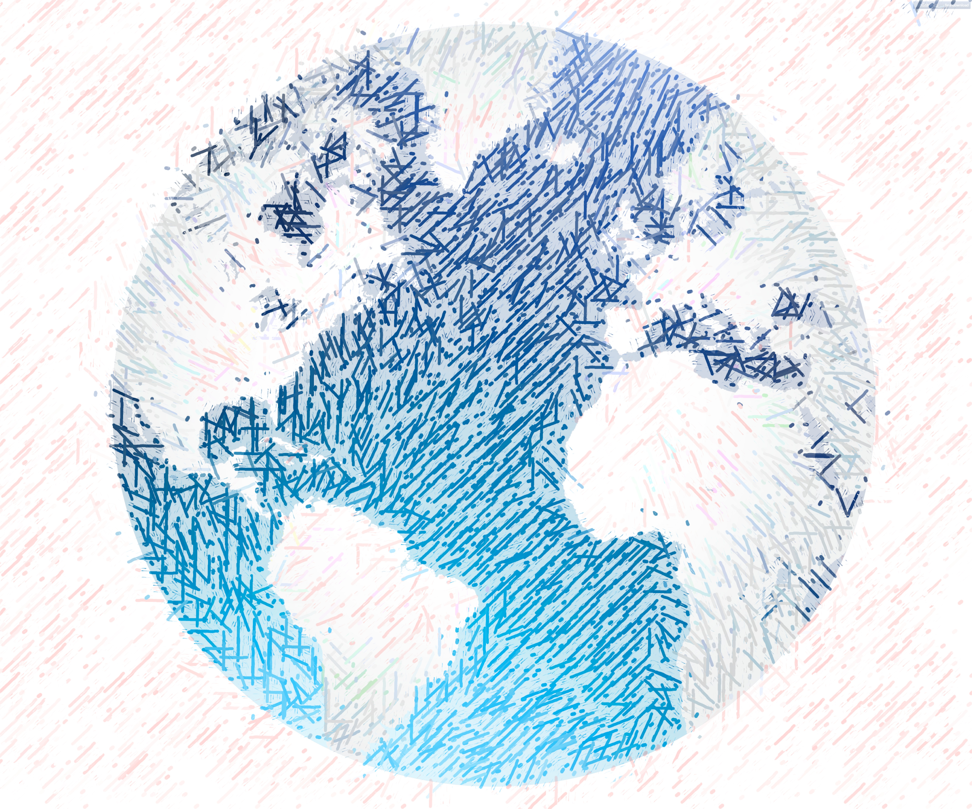


Mental Models

Slide 4
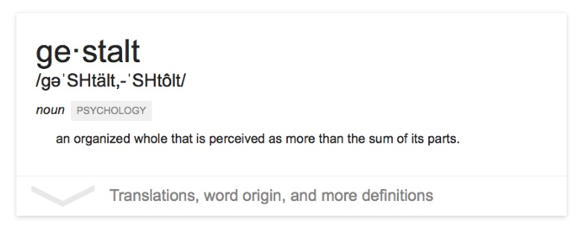
The “gestalt effect”
Our brain’s ability to generate whole forms, instead of just collections of unrelated elements

Slide 5




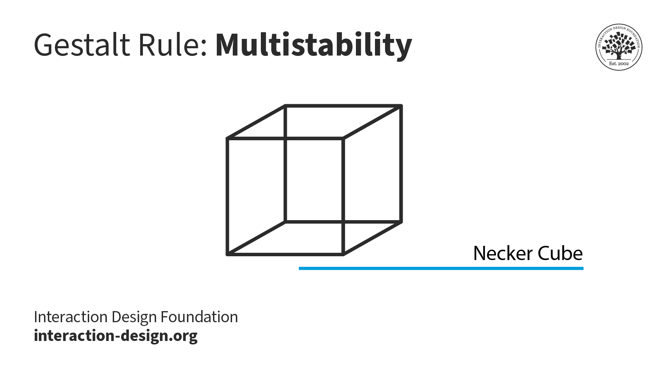
Emergence
Reification
Multistability
Invariance
Gestalt effects
Demonstration of reification in perception from Lehar S. (2003) The World In Your Head, Lawrence Erlbaum, Mahwah, NJ. p. 52, Fig. 3.3
https://www.interaction-design.org/literature/topics/gestalt-principles#docs-internal-guid-f7074e47-7fff-b4dc-f0f5-966e09f6b4e7
https://www.interaction-design.org/literature/topics/gestalt-principles#docs-internal-guid-f7074e47-7fff-b4dc-f0f5-966e09f6b4e7
Demonstration of invariance in perception from Lehar S. (2003) The World In Your Head, Lawrence Erlbaum, Mahwah, NJ. p. 53, Fig. 3.5
Notes:
Reification – we prefer complete shapes, so we fill in the gaps between elements to complete the image
Emergence – See the big picture first, connect small parts into a big picture
Multistability – Many ways to interpret, but only see one at a time; front is back, front is front, diamond in middle
Invariance – see basic shapes as identical regardless of transformations

Slide 6
What does this mean for visualization?
Question: what makes all this mental model stuff useful to us (designers and readers of data)?
Answer: in order to understand how people interpret and make sense of data, we need to know what cues they’re picking up on – and how to situate those cues within a larger framework
6 “Laws of Grouping”

Slide 7
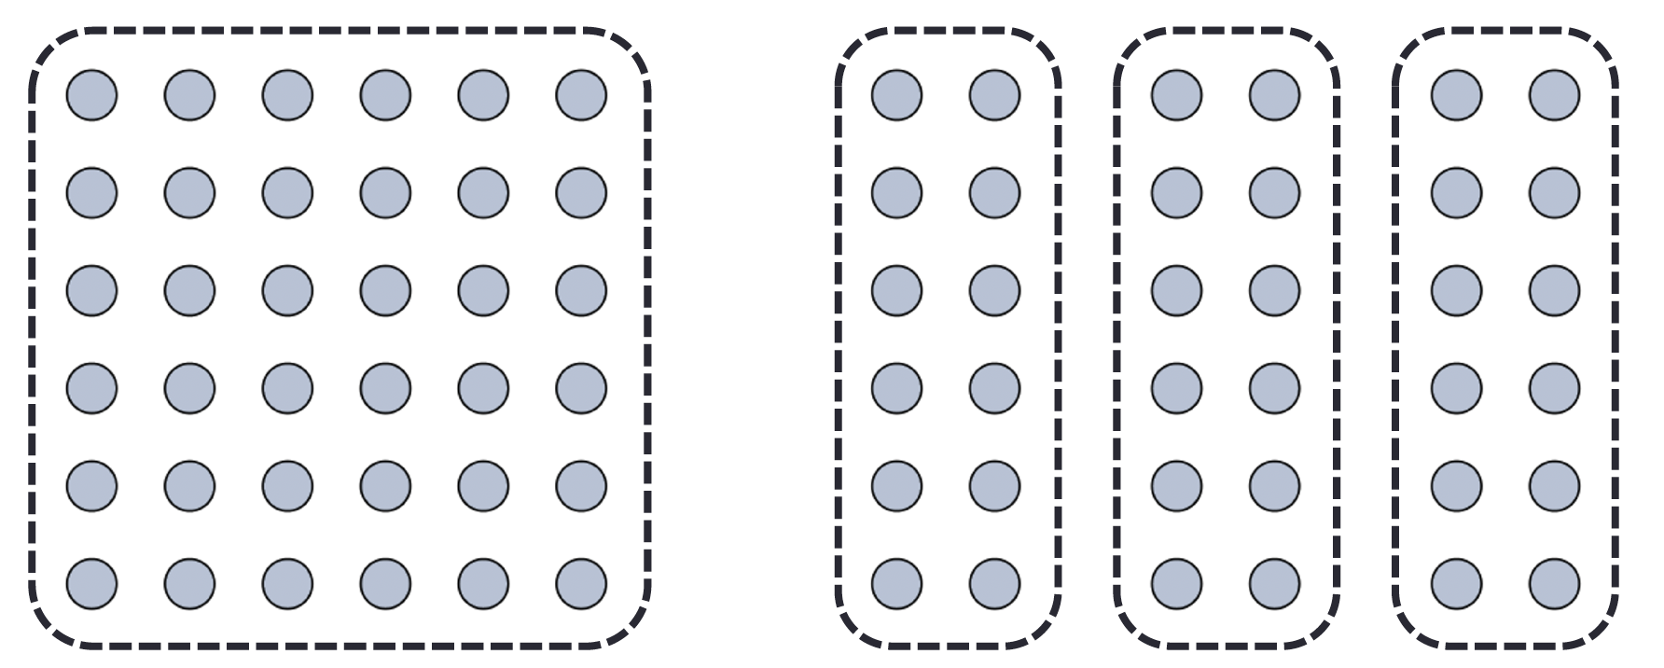
We interpret objects that are close to each other as a group
Law of Proximity

Slide 8
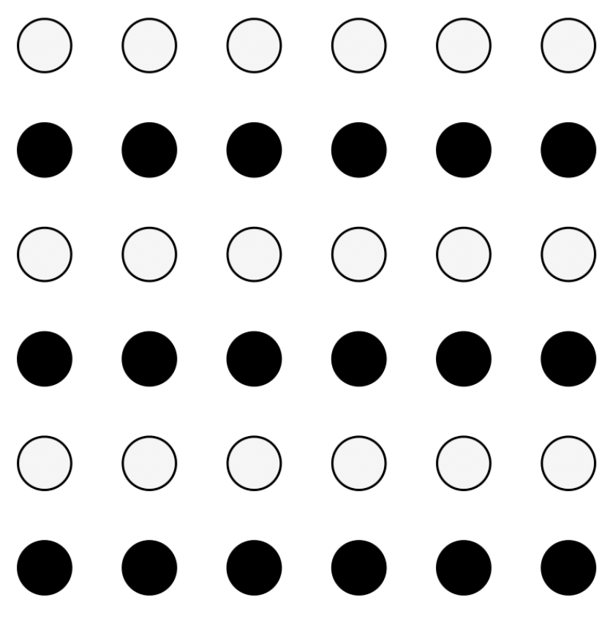
We interpret objects that are visually similar to each other as a group
Law of Similarity
“grey dots”
“black dots”

Slide 9

When parts of a picture are missing, we fill in the visual gap
Law of Closure

Slide 10
Law of Symmetry
We perceive objects as being symmetrical, arranged around a center point
law of proximity
[ ] { } [ ]
law of symmetry + law of similarity

Slide 11
We group objects that we perceive to be moving along the same path
Law of Common Fate

Slide 12
We tend to group objects along the smoothest path
Law of Continuity

Slide 13
Break into teams of 3
Choose a visualization from the Tableau Vis of the Day collection: https://public.tableau.com/app/discover/viz-of-the-day
Write the title on the board so we don’t get repeats!
Goal: identify as many examples of the Laws of Grouping (Gestalt Principles) in action in your sample visualization as you can
Be prepared to present your findings to the class
Let’s Practice

Slide 14

Group activity: what we draw vs. what we see
Let’s Practice
proximity
similarity
closure
[ ]
symmetry
common fate
continuity

Slide 15
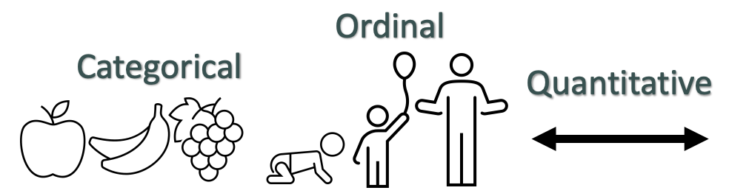
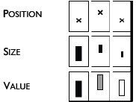

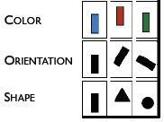
Data → Visuals
Remember… Big idea behind visualization
Map data dimensions to visual dimensions in a principled way
Not all visual dimensions can represent all data types
Jacques Bertin, Semiologie Graphique
(Semiology of Graphics), 1967.

Slide 16
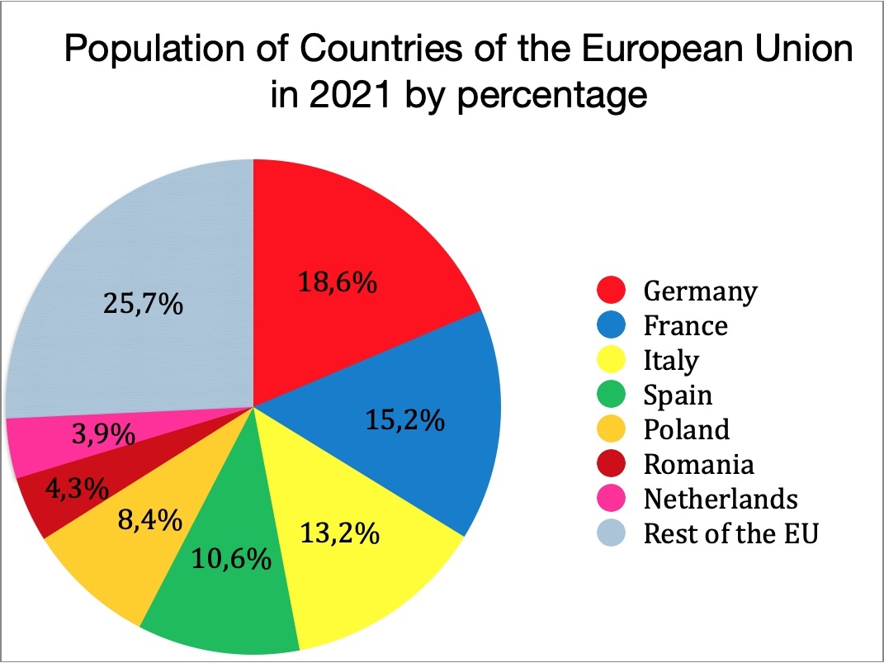
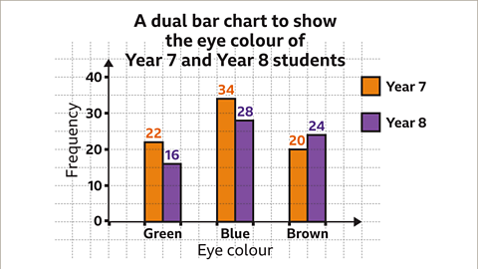
Data → Visuals
Data → Visual Mapping is the description of what data if represented by what visual channel.
Ex.
Remember… Big idea behind visualization
Map data dimensions to visual dimensions in a principled way
Not all visual dimensions can represent all data types
Jacques Bertin, Semiologie Graphique
(Semiology of Graphics), 1967.

Slide 17
Match Channel Type to Data Type
Ordered Data / Magnitude Channels
Principle 1: expressiveness
Fig. Courtesy of M Krzywinski
Notes:
The expressiveness of a visual encoding should “express all of, and only, the attributes of the data.” It is violated when we use encodings that do not match our data type or our visualization goals. When it fails, a chart is not only sub-optimal and confusing, it can be incorrect and misleading. Charts can fail the expressiveness test if their encodings imply ordering when there actually is none, or they mis-order a variable.

Slide 18
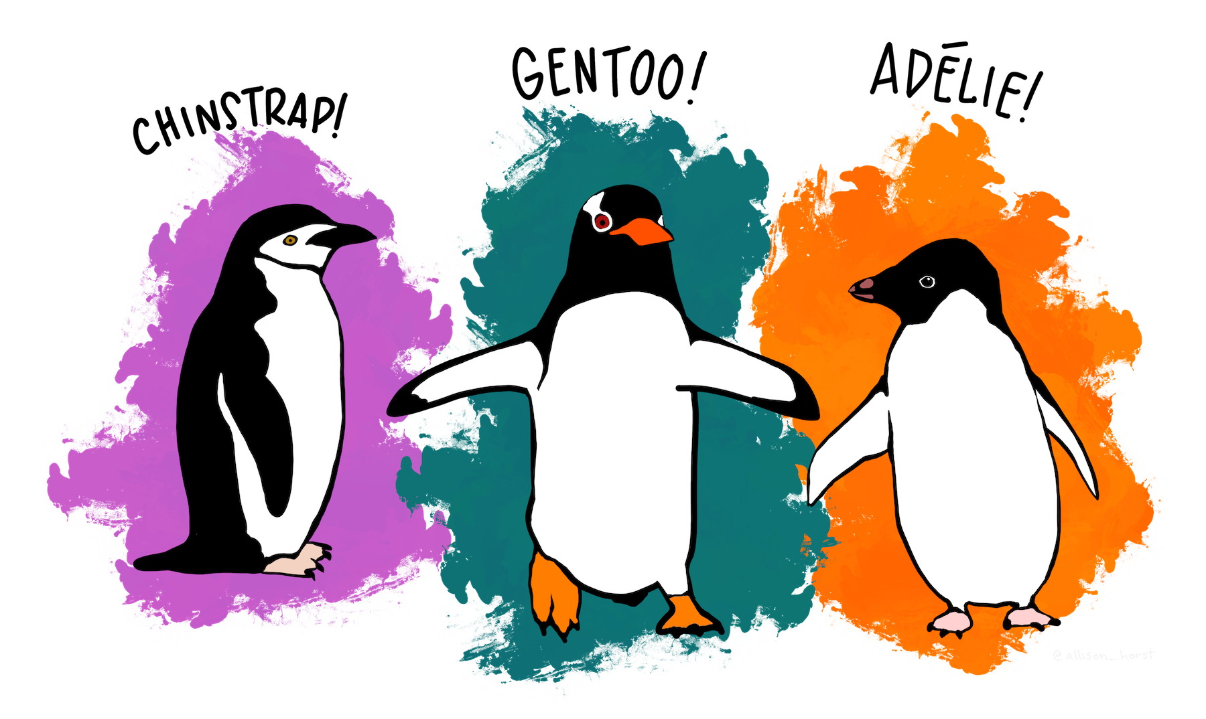
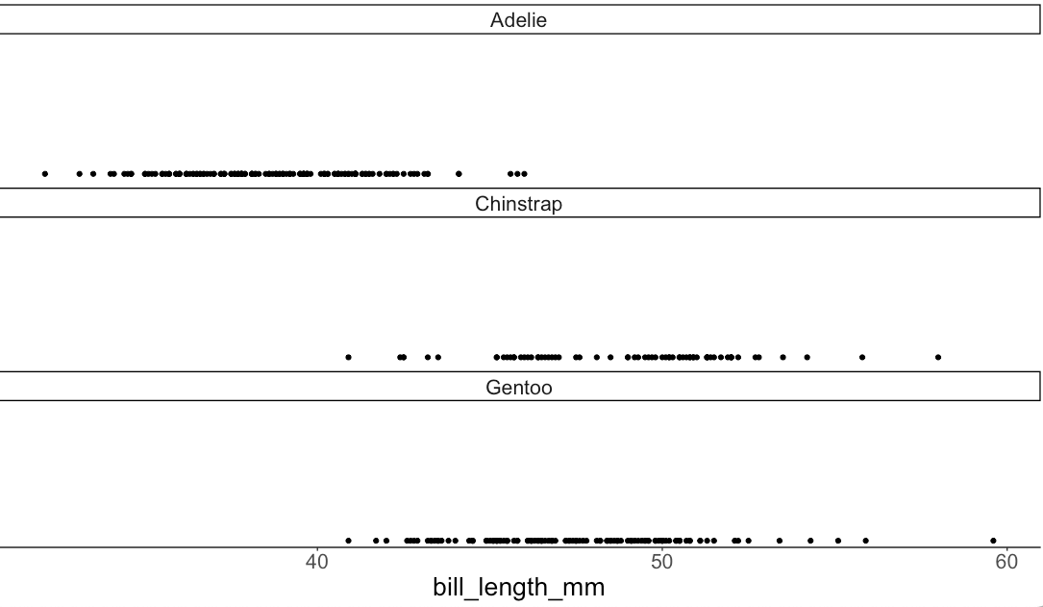
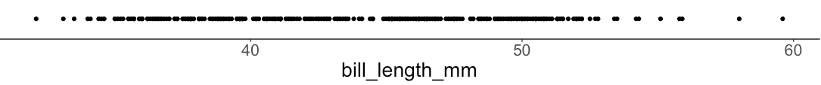
Encode all the facts
Principle 1: expressiveness
https://allisonhorst.github.io/palmerpenguins/#meet-the-palmer-penguins
Notes:
https://allisonhorst.github.io/palmerpenguins/#meet-the-palmer-penguins
Species, island, bill_length, bill_depth, flipper_length, body_mass

Slide 19
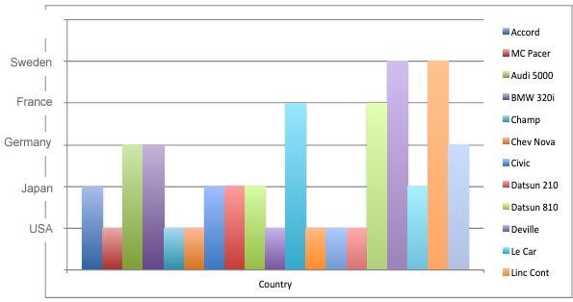
Only the facts
Principle 1: expressiveness
Adapted from Mackinlay J (1986) Automating the design of graphical presentations of relational information.
Notes:
Height implied sweeden is better

Slide 20
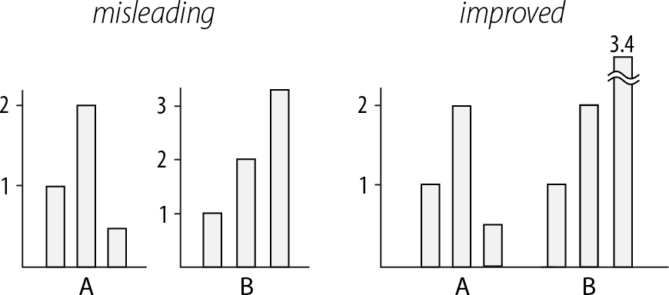
Use consistent axes when comparing charts
Principle 2: consistency
Raina SZ, et al. (2005) Evolution of base-substitution gradients in primate mitochondrial genomes. Genome Res 15: 665-673.
M. Krzwinski, behind every great visualization is a design
principle, 2012

Slide 21
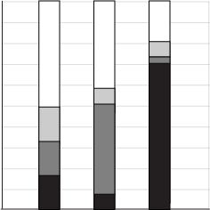
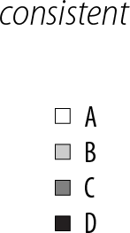
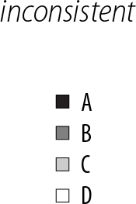
A note on legends: order items according to appearance
Principle 2: consistency
M. Krzwinski, behind every great visualization is a design principle, 2012

Slide 22
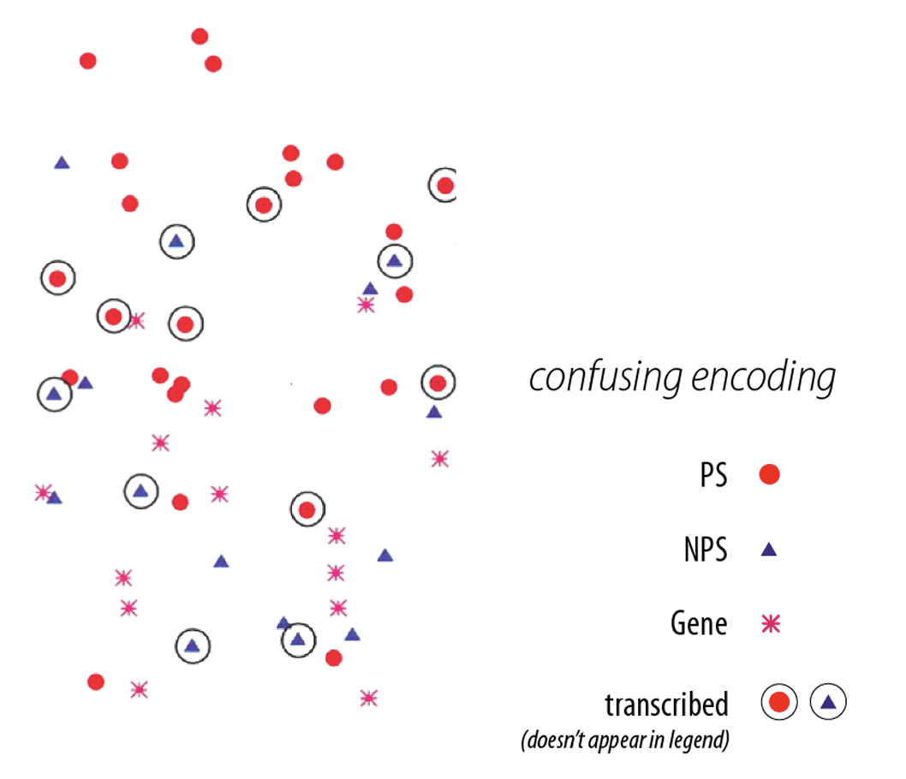
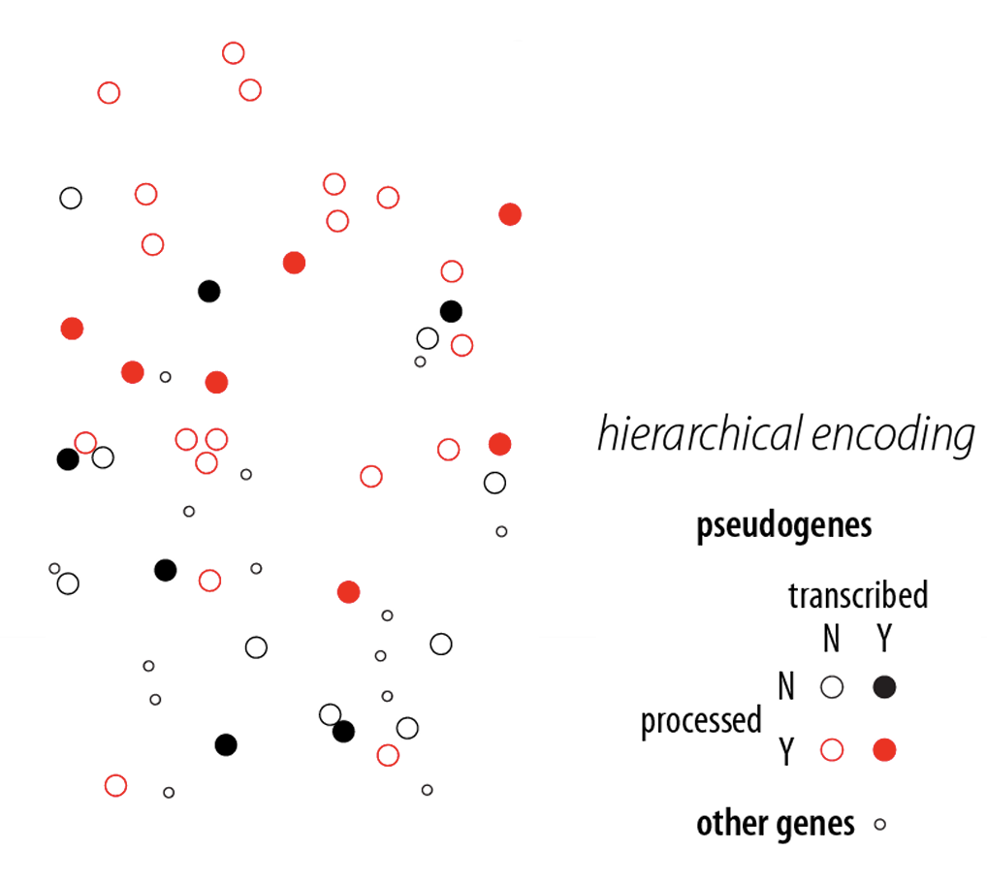
Visual variation should reflect and enhance the underlying variation in the data
Avoid visually similar encodings for independent variables
Example:
Principle 2: consistency
Fig. 2: M. Krzwinski, behind every great visualization is a design principle, 2012
Notes:
red - processed genes, but salience attenuated Ø ➢ other genes encoded with competing glyph - red star.

Slide 23
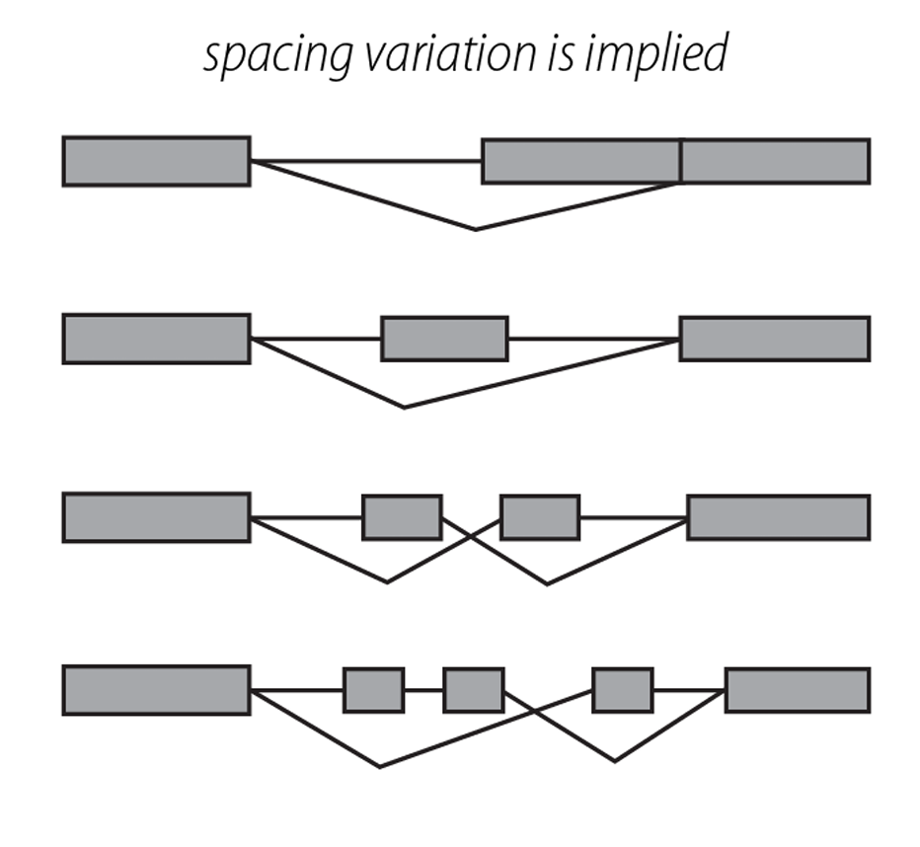
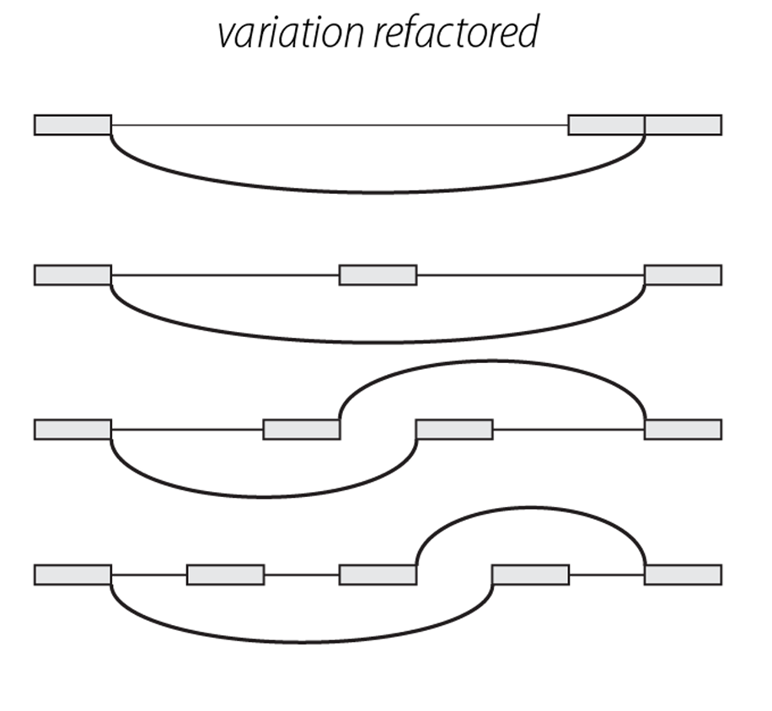
Uniform size and alignment reduces visual complexity and aids interpretation
Example:
Principle 2: consistency
Fig. 1: Sharov AA et al. (2005) Genome-wide assembly and analysis of alternative transcripts in mouse. Genome Res 15: 748-754.
Fig. 2: M. Krzwinski, behind every great visualization is a design principle, 2012

Slide 24

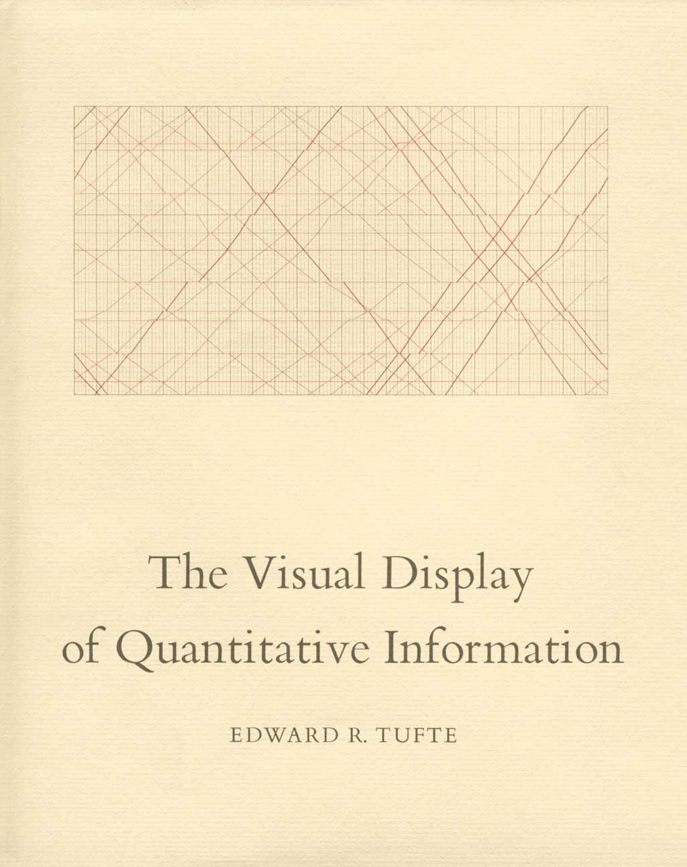
Tufte, 1983
“Above all else, show the data.”
Notes:
Kind of old news

Slide 25
Tufte, 1983
Data-ink
Data-ink ratio =
Total ink used to print the graphic
= proportion of a graphic's ink devoted to the non-redundant display of data-information
= 1 - proportion of a graphic that can be erased

Slide 26
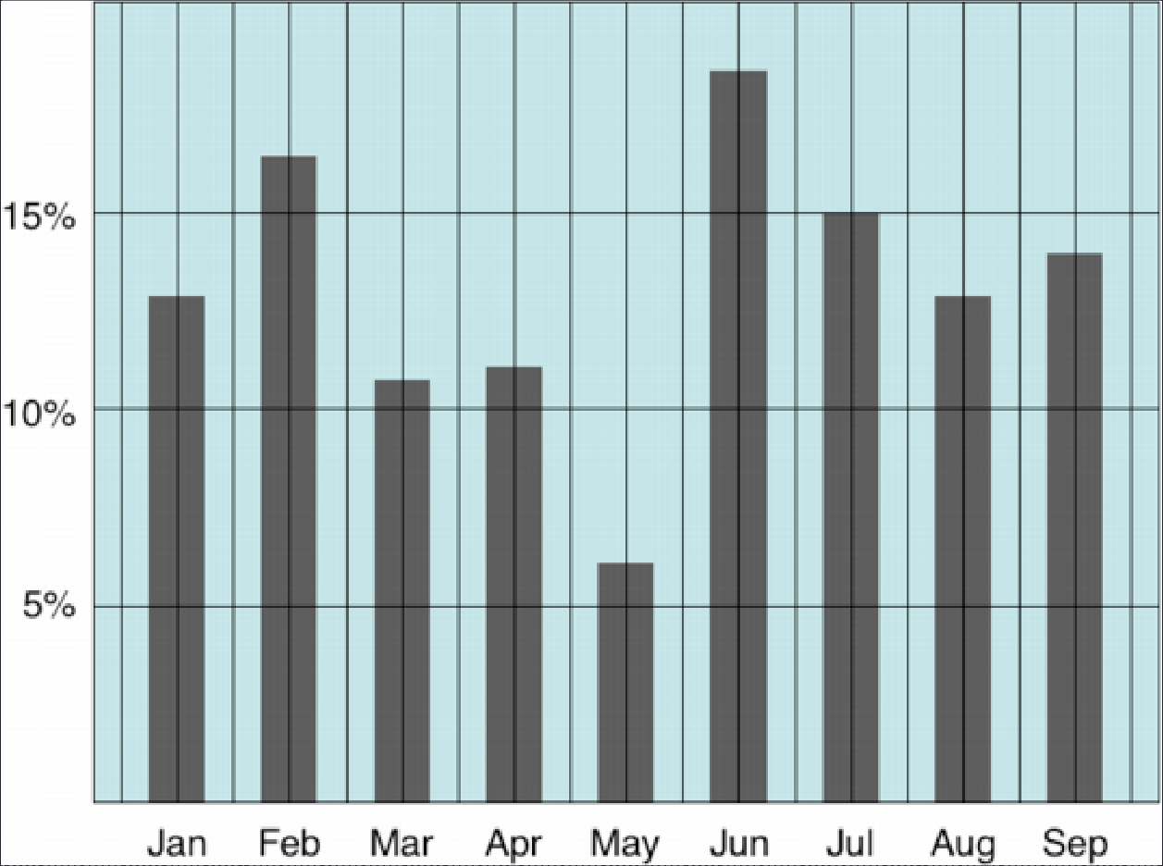
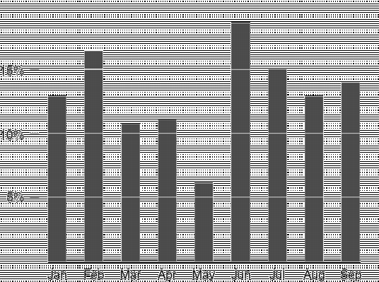

Tufte: maximize the data-ink ratio

Slide 27
Discussion
What do you think of the data-ink ratio?
Think of 3 specific ways to maximize it
Do you think there are limits or tradeoffs to this design approach?

Slide 28
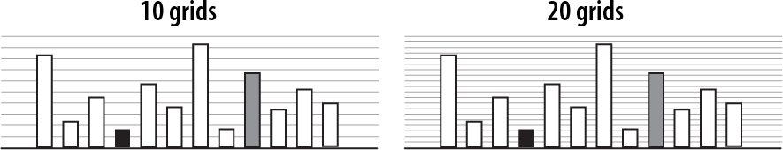
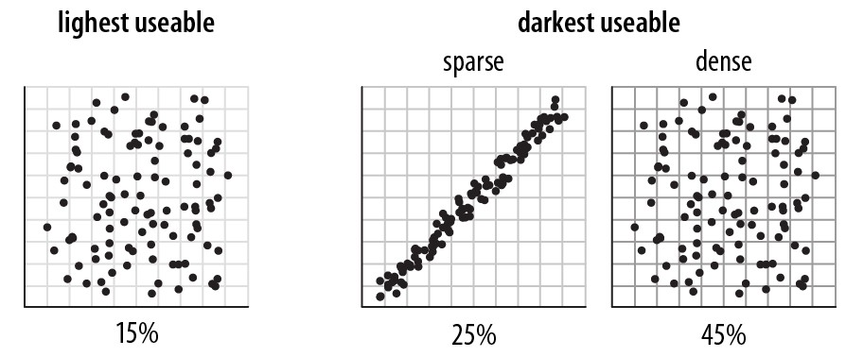
Navigational aids shouldn’t compete with data
Avoid: heavy axes, error bars and glyphs
Principle 3: importance ordering
Heer J, Bostock M (2010) Crowdsourcing graphical perception: using mechanical turk to assess visualization design. Proceedings of the 28th international conference on Human factors in computing systems. Atlanta, Georgia, USA: ACM. pp. 203-212.

Slide 29
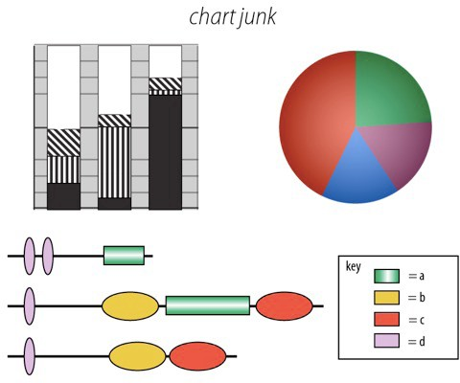
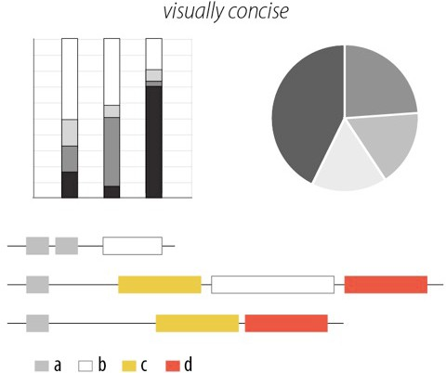
Simplify, simplify, simplify…
Principle 3: importance ordering
Sharov AA, et al (2006) Genome Res 16: 505-509.
Peterson J, et al. (2009) Genome Res 19: 2317-2323.
Thomson NR, et al. (2005) Genome Res 15: 629-640.
DB, Ko MS (2005) Genome Res 15: 748-754.
M. Krzwinski, behind every great visualization is a design
principle, 2012

Slide 30
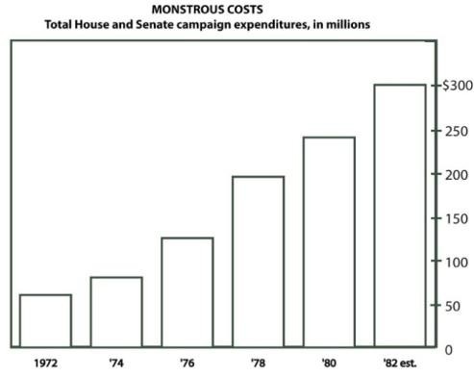
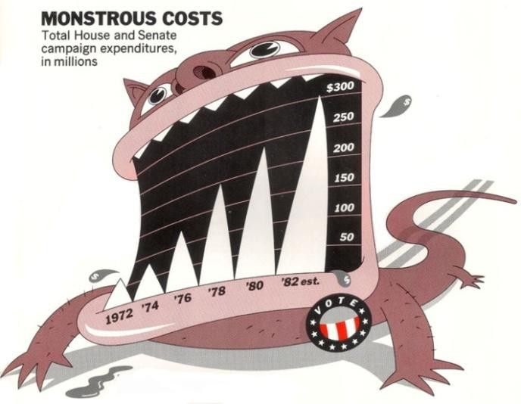

A caveat: “chart junk” and recall
Bateman et al. “Useful Junk? The Effects of Visual Embellishment on Comprehension and Memorability of Charts”, CHI 2010

Slide 31
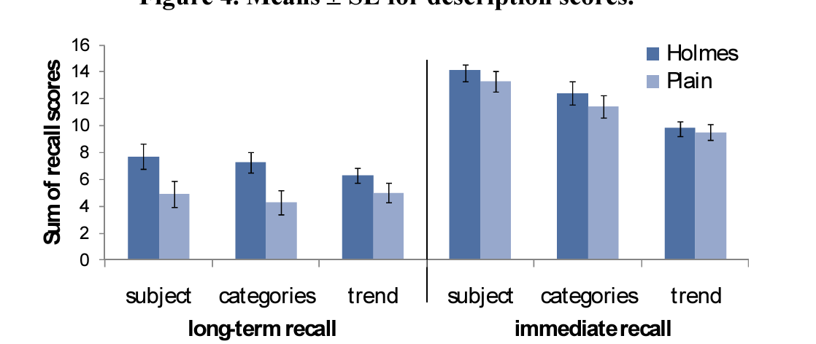
A caveat: “chart junk” and recall
Bateman et al. “Useful Junk? The Effects of Visual Embellishment on Comprehension and Memorability of Charts”, CHI 2010

Slide 32
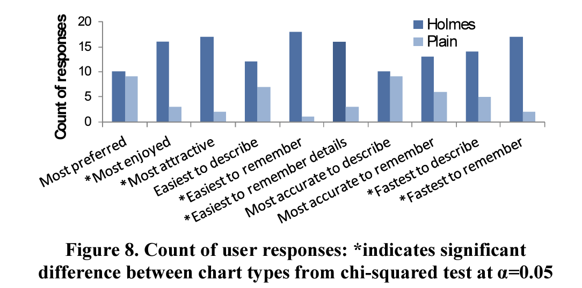
A caveat: “chart junk” and preference
Bateman et al. “Useful Junk? The Effects of Visual Embellishment on Comprehension and Memorability of Charts”, CHI 2010

Slide 33
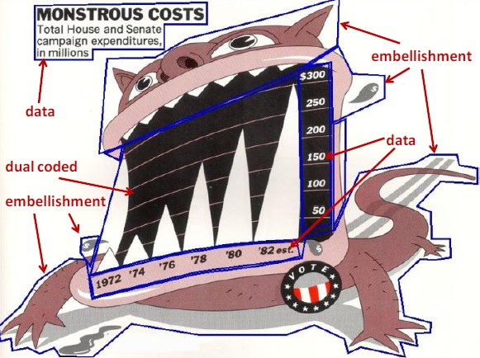
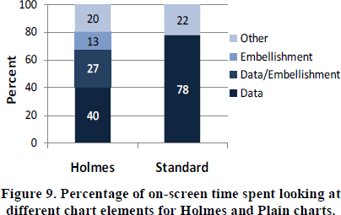
Chart junk and eye gaze
Notes:
Although 40% of users’ time was spent looking at embellishments for Holmes charts, this did not result in a longer time to describe the charts.

Slide 34
Returning to the Marks and Channels Activity
Work with 2 other people. Be prepared to share your work with the class.
Find a data visualization you think is interesting
Some ideas: New sites, government sites, Tableau, massvis.mit.edu
Write down what you chose on the board so we don’t get repeats!
Answer:
Why did you choose this specific visualization?
Does the visualization follow all the design principles we just looked at?
If not, which are violated and how?
Do you think your answer to (2) impacted your answer to (1)?

